Slide 1
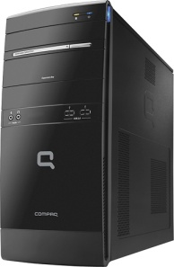
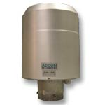
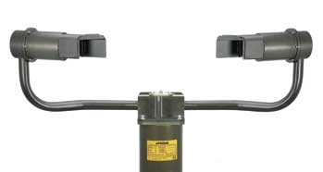

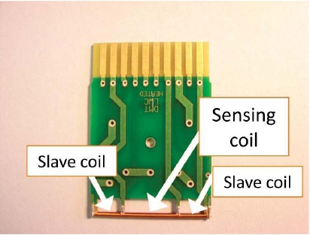
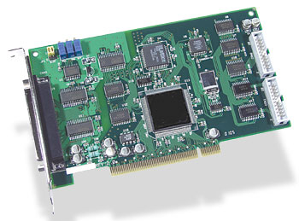
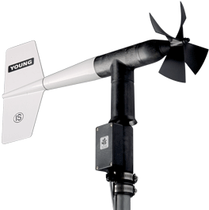

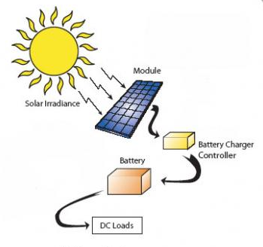
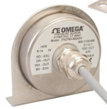

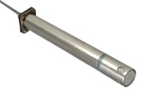
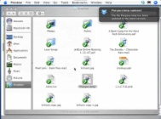
Environmental Sensing and Fog Collector Monitoring System (ESAMS)
Acquisition and Control
Collector Monitoring
Environmental Sensing
Optical Fog
Detector
Flow Meter
Computer
Camera
Liquid Water
Content Probes
Data
Acquisition
Wind Vane
Anemometer
Power
Data Logging
Barometric
Pressure,
Sensors
Data Transfer
Humidity,
Temperature
Sensors
Data
Distribution

Slide 2
ESAMS Deployment Concept
Upstream
Sensors
Note: Upstream and downstream
Sensors include LWC, temperature,
and wind speed and direction
Fog
Collector
(Side View)
Wind
Downstream
Sensors
Collector Monitoring Subsystem
Power Subsystem
Data Acquisition Subsystem
Optical Fog Detector
Pressure, Humidity, and Temperature Sensors

